Slide 1
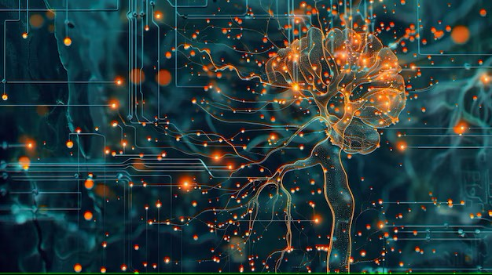



Week-1 (Discussion)
28th Jan, 2025
Deep Learning
Prof. Sudarshan Iyenger
Professor and Head of the Department
Department of Computer Science and Engineering
IIT Ropar
Ayan Paul
PMRF Research Scholar
IIT Kharagpur

Slide 2
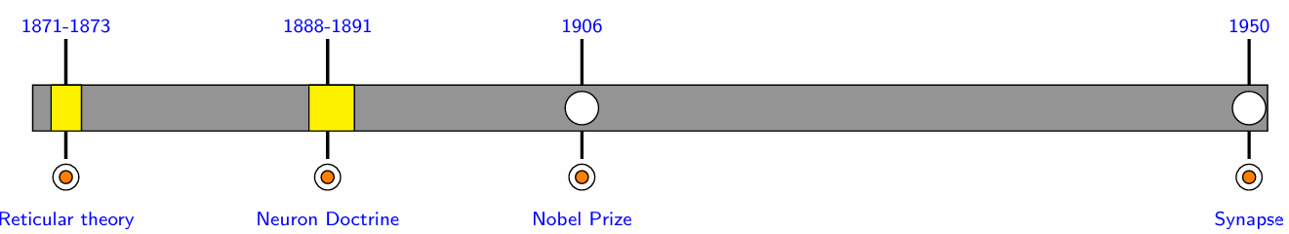
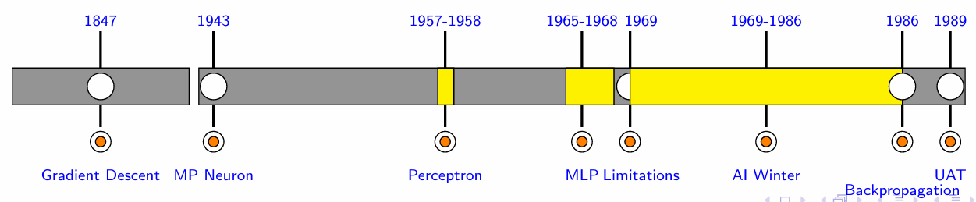
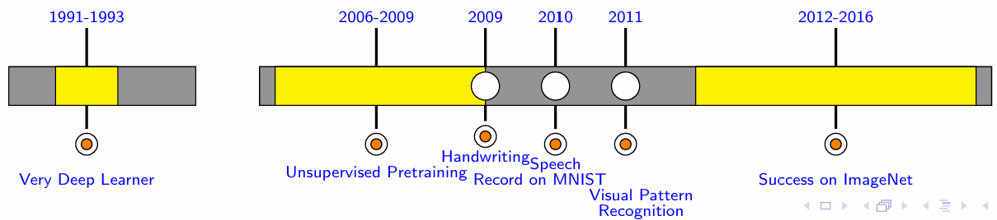
TIMELINE OF DEEP LEARNING

Slide 3
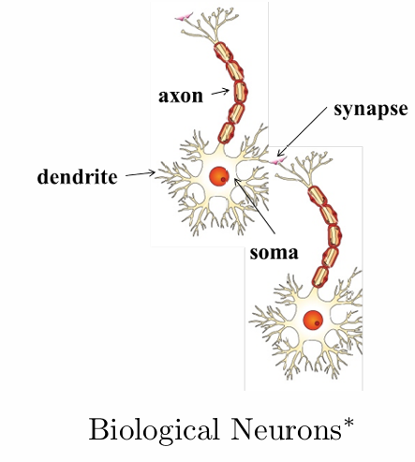
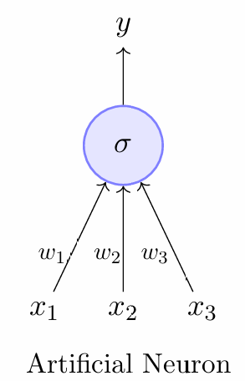
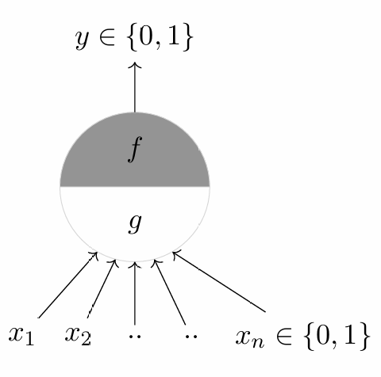
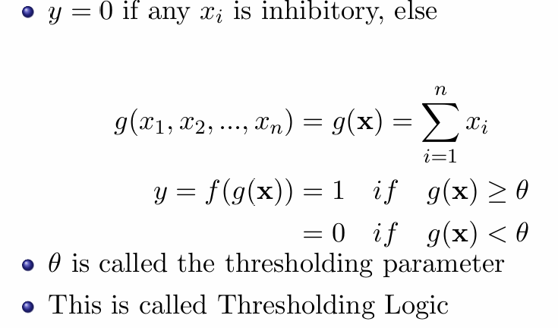
Analogy between Biological and Artificial Neuron
The most fundamental unit of a deep neural network is called an artificial neuron.
The inspiration comes from biology (more specically, from the brain)
biological neurons = neural cells =neural processing units
dendrite: receives signals from other neurons
synapse: point of connection to other neurons
soma: processes the information
axon: transmits the output of this neuron
McCulloch Pitts Neuron

Slide 4
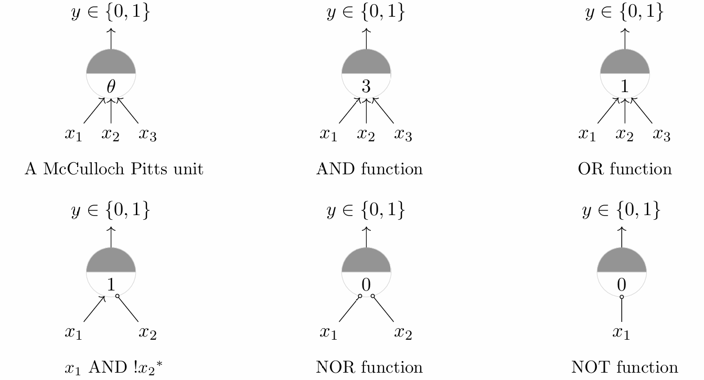
Threshold for the Boolean Function

Slide 5
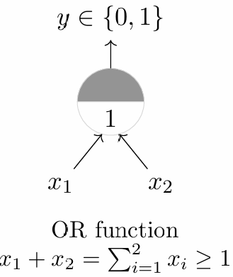
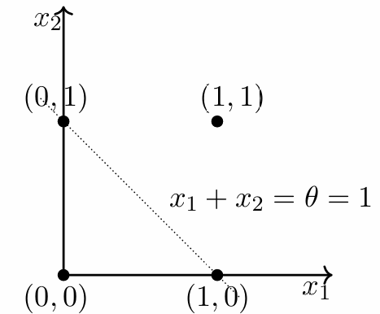
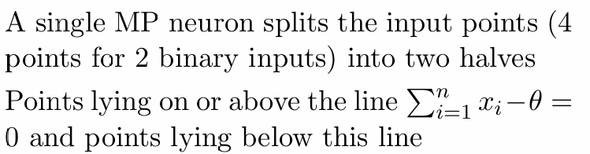
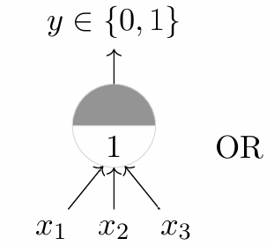
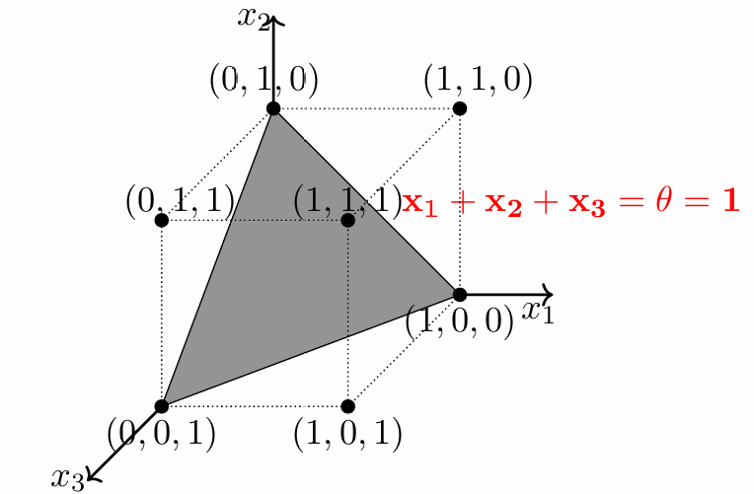
McCulloch Pitts Neuron applied for Boolean functions
A single McCulloch Pitts Neuron can be used to represent Boolean functions which are linearly separable
Linear separability (for Boolean functions) : There exists a line (plane) such that all inputs which produce a 1 lie on one side of the line (plane) and all inputs which produce a 0 lie on other side of the line (plane)

Slide 6
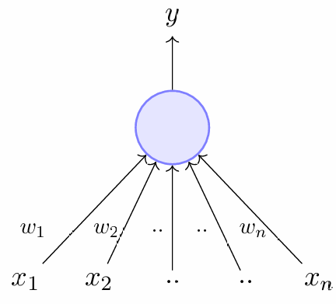
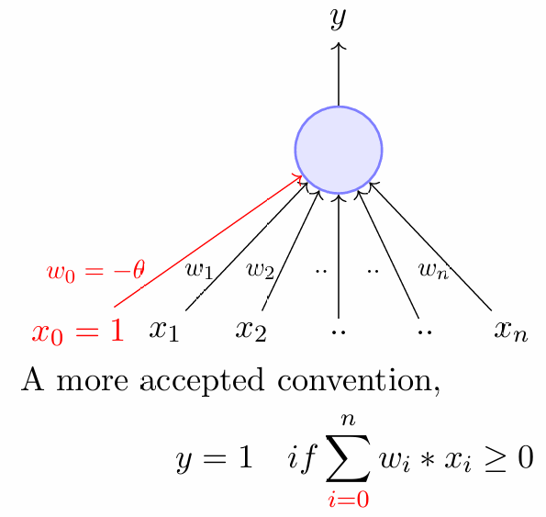
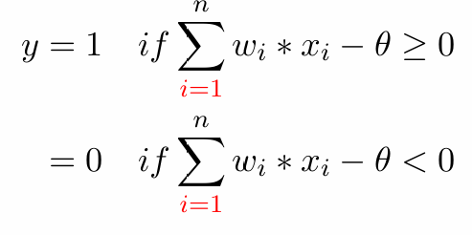

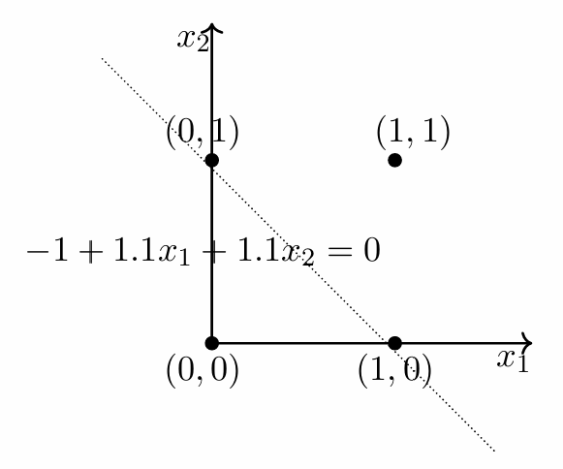
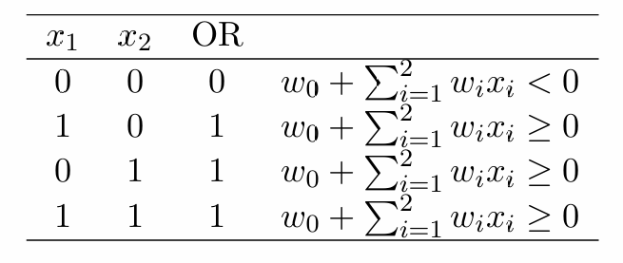
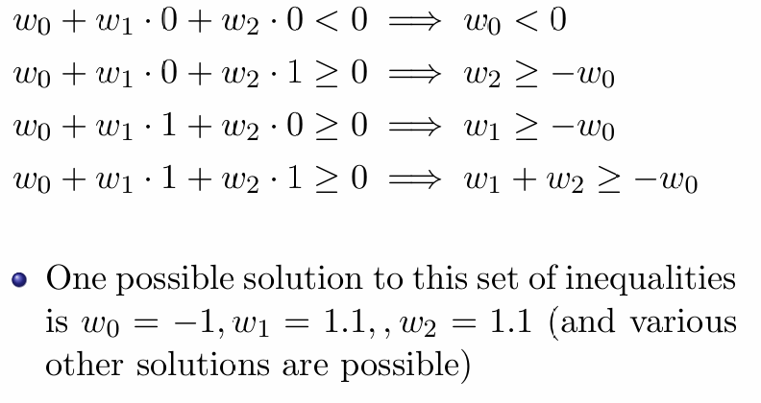
Perceptron
Inputs are no longer limited to Boolean values
Introduction of numerical weights for inputs
Perceptron applied for Boolean function

Slide 7
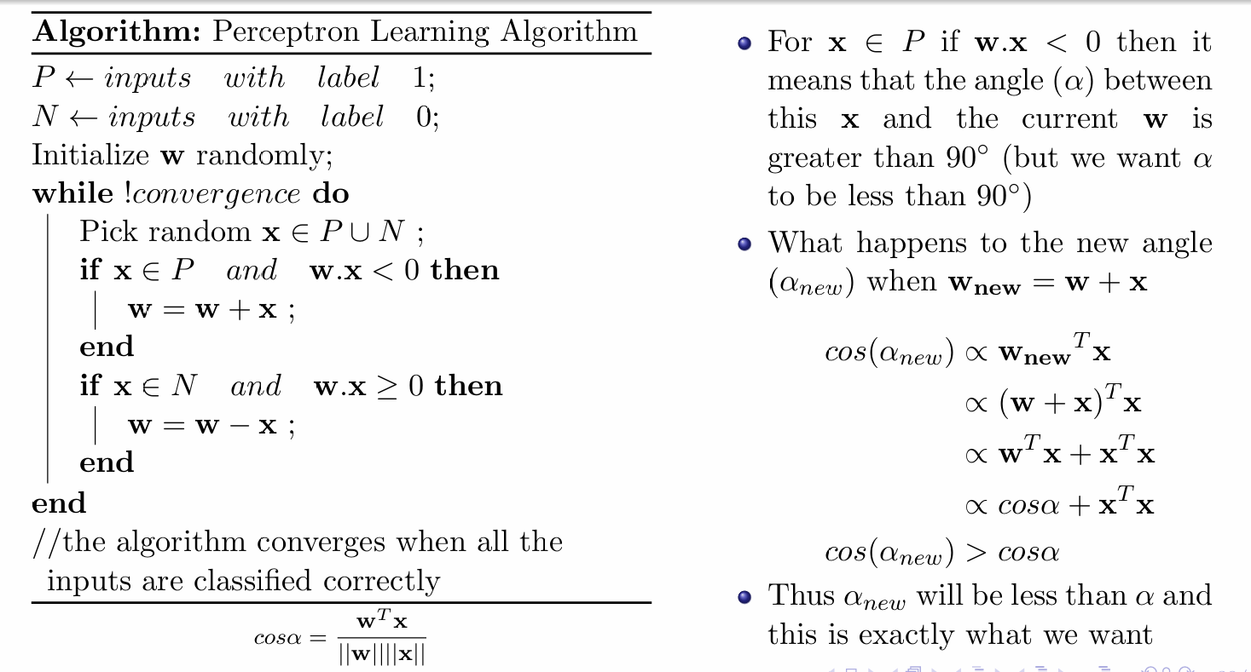
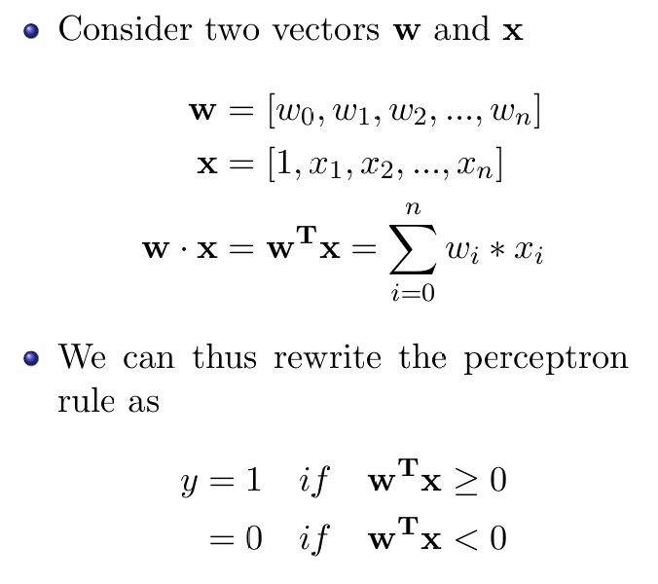
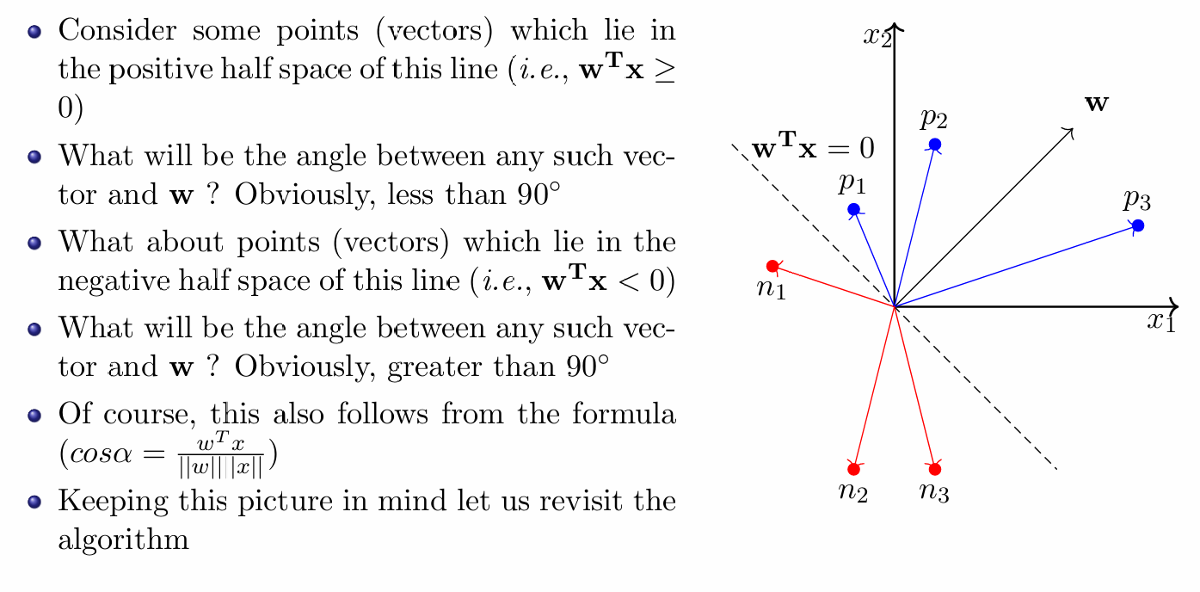
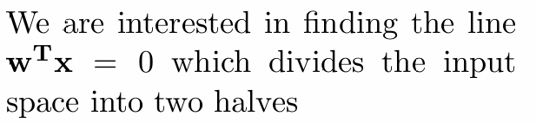
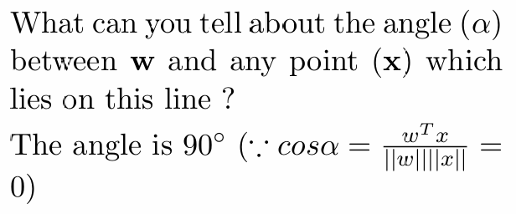
Perceptron Learning Algorithm

Slide 8
How Perceptron Learning Algorithm Works

Slide 9
Topics on which Week 1 Assignment Questions are based
Deep Learning Timeline
McCulloch Pitts Neuron
Perceptron
Perceptron Learning Algorithm

Slide 10
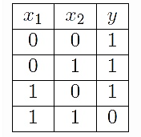
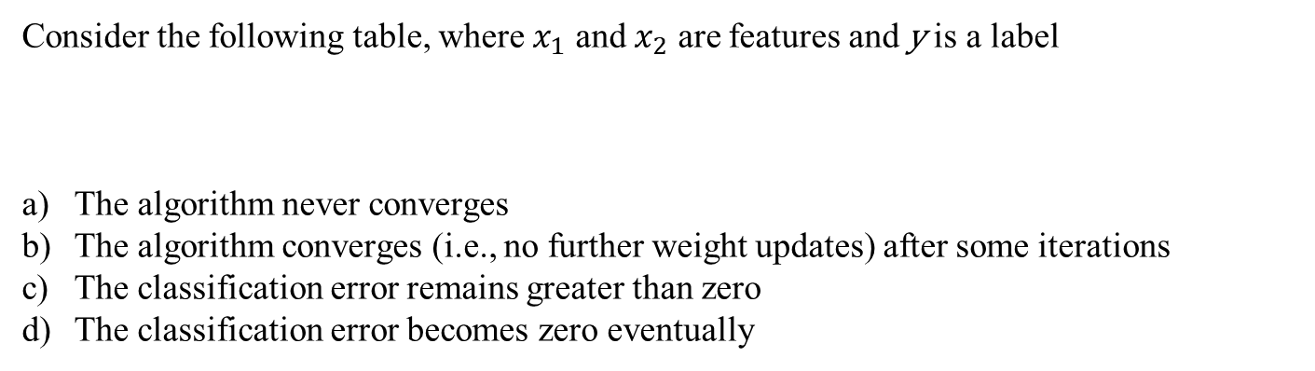
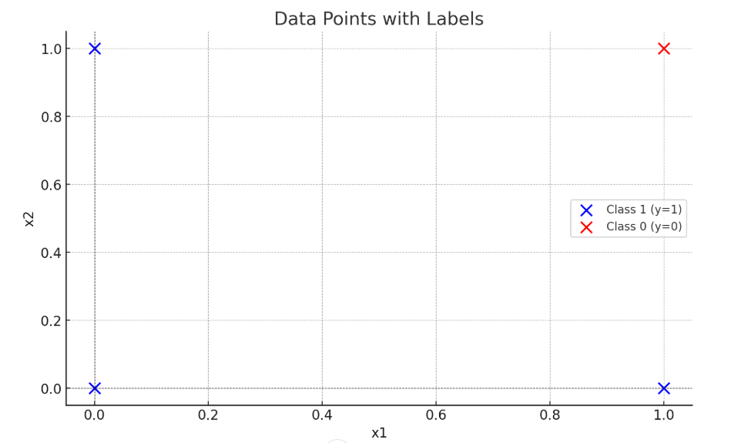
QUESTION 1
Assume that the elements in w are initialized to zero and the perception learning algorithm is used to update the weights w. If the learning algorithm runs for long enough iterations, then
SOLUTION 1
As dataset is linearly separable
The algorithm converges (i.e., no further weight updates) after some iterations
The classification error becomes zero eventually
CORRECT ANSWER 1
b), d)

Slide 11
QUESTION 2
In the perceptron model, the weight w vector is perpendicular to the linear decision boundary at all times.
True
False
SOLUTION 2
In the perceptron model, the weight w vector is perpendicular to the linear decision boundary at all times. True
CORRECT ANSWER 2
a)

Slide 12
QUESTION 3
What is the perceptron algorithm used for?
Clustering data points
Classifying data
Solving optimization problems
Finding the shortest path in a graph
SOLUTION 3
The Perceptron algorithm is a supervised learning algorithm used for binary classification tasks. It attempts to find a linear decision boundary that separates data points into two distinct classes.
Key Features:
It updates the weights iteratively based on the classification error until convergence (if the data is linearly separable).
It works by minimizing misclassifications through weight adjustments.
CORRECT ANSWER 3
b)

Slide 13

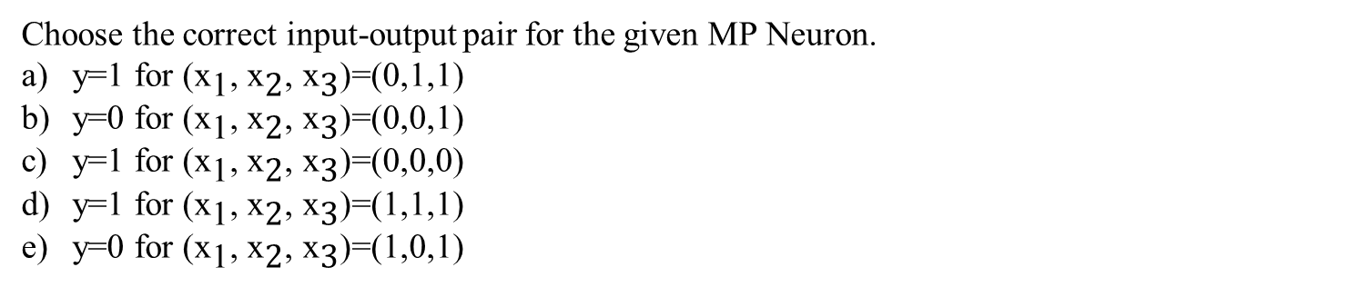
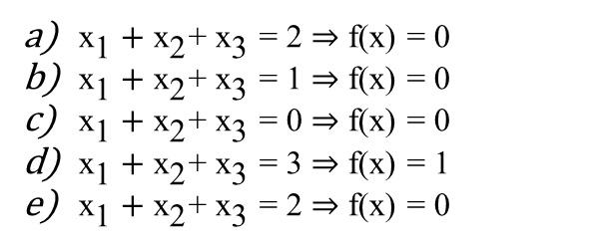
QUESTION 4
SOLUTION 4
CORRECT ANSWER 4
b), d), e)

Slide 14
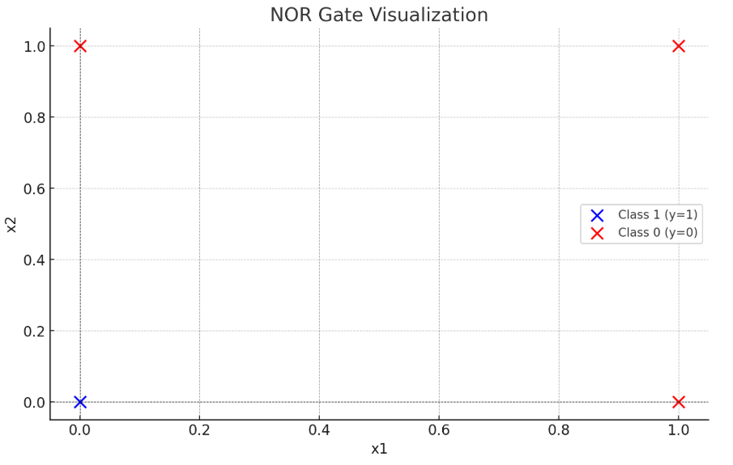
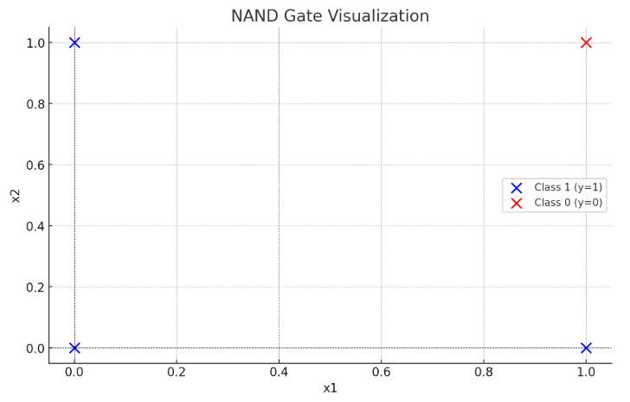
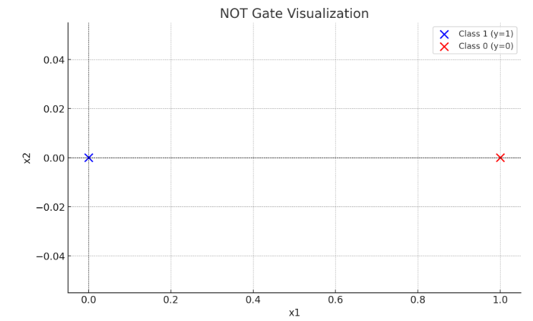
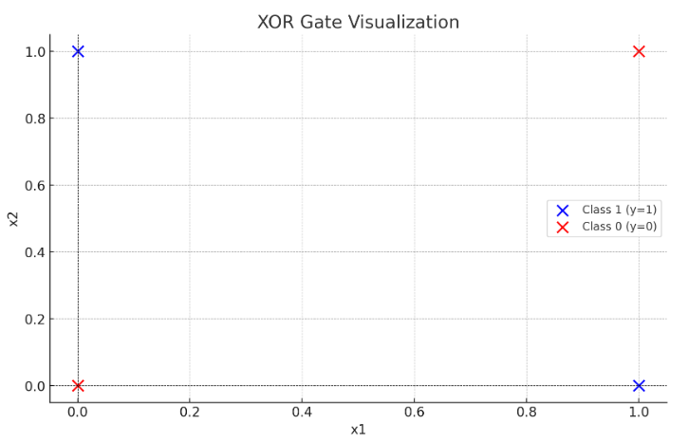
QUESTION 5
Which of the following Boolean functions can be implemented using a perceptron?
NOR
NAND
NOT
XOR
SOLUTION 5
As data for NOR, NAND and NOT are linearly separable, perceptron can be implemented
CORRECT ANSWER 5
a), b), c)

Slide 15
QUESTION 6
Which of the following threshold values of MP neuron implements AND Boolean function? Assume that the number of inputs to the neuron is 7 and the neuron does not have any inhibitory inputs.
1
3
6
7
8
SOLUTION 6
CORRECT ANSWER 6
d)

Slide 16
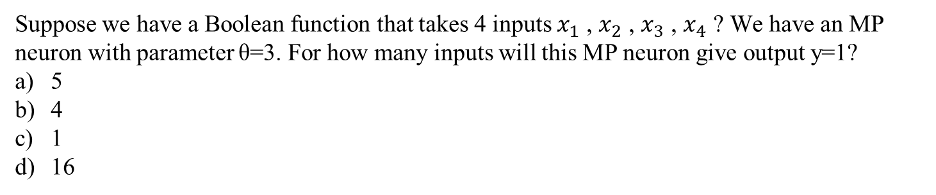

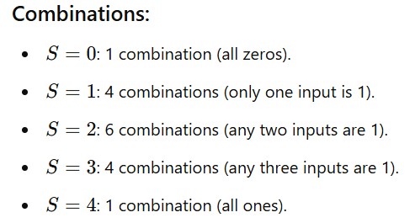
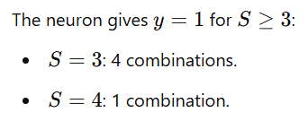
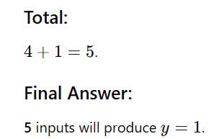
QUESTION 7
SOLUTION 7
CORRECT ANSWER 7
a)

Slide 17
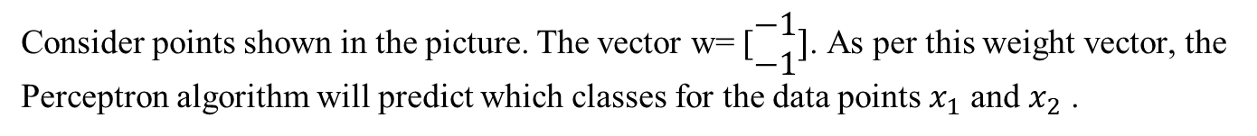

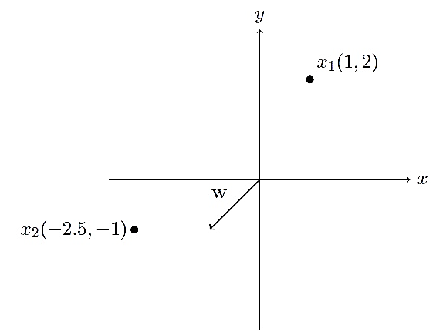
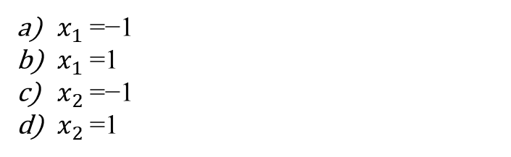
QUESTION 8
SOLUTION 8
CORRECT ANSWER 8
a), d)

Slide 18
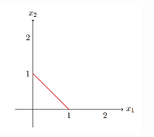
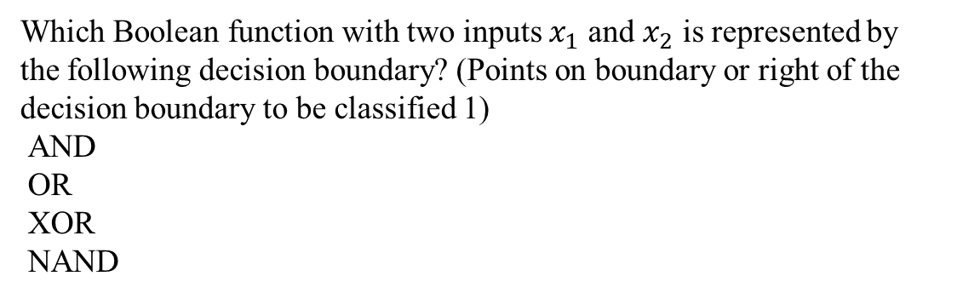
QUESTION 9
a)
b)
c)
d)
SOLUTION 9
CORRECT ANSWER 9
b)

Slide 19
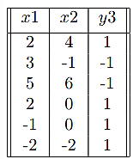
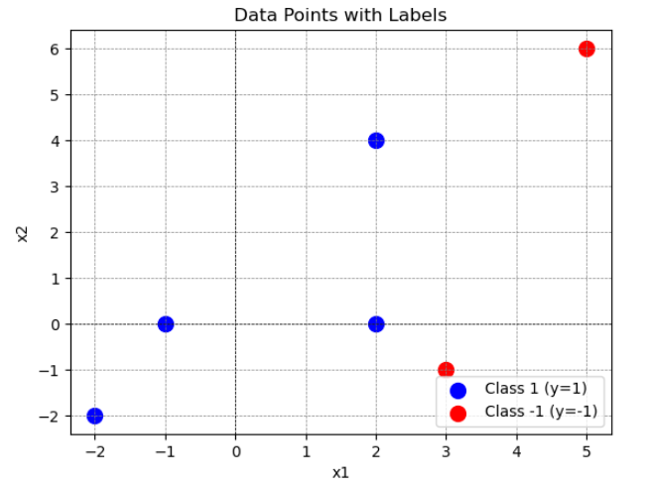
QUESTION 10
We are given the following data:
Can you classify every label correctly by training a perceptron algorithm?
Yes
No
SOLUTION 10
Yes as data is linearly separable
CORRECT ANSWER 10
b)

Slide 20
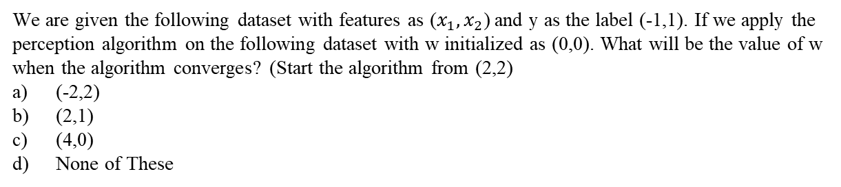
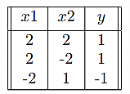
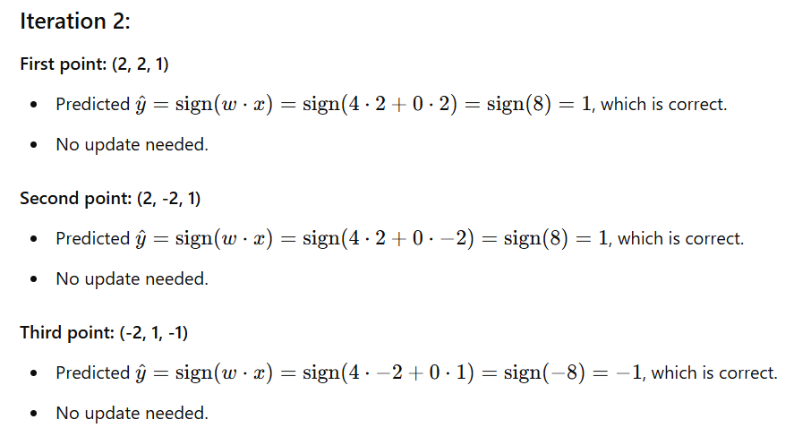
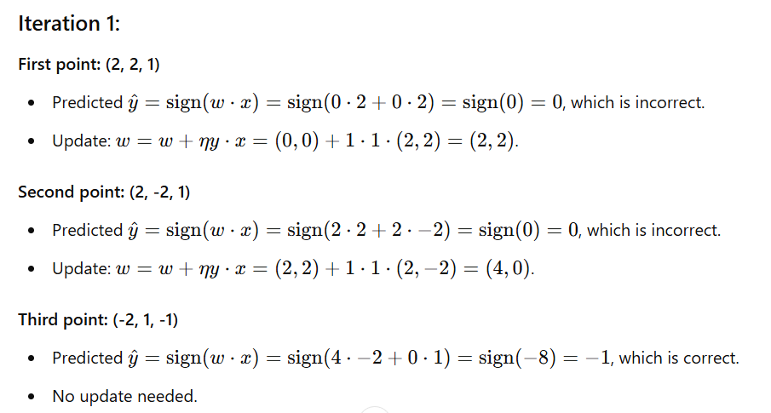
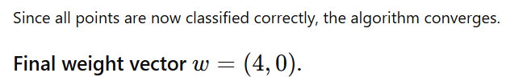
QUESTION 11
SOLUTION 11
CORRECT ANSWER 11
c)

Slide 21

QUESTION 12
SOLUTION 12
For any inhibitory input, y =0
CORRECT ANSWER 12
a)

Slide 22
QUESTION 13
What is the “winter of AI” referring to in the history of artificial intelligence?
The period during winter when AI technologies are least effective due to cold temperatures
A phase marked by decreased funding and interest in AI research.
The season when AI algorithms perform at their peak efficiency.
A period characterized by rapid advancements and breakthroughs in AI technologies.
SOLUTION 13
A phase marked by decreased funding and interest in AI research
CORRECT ANSWER 13
b)

Slide 23

QUESTION 14
What is the output of a perceptron with weight vector w=[2 −3 1] and bias b=−2 when the input is x=[1 0 −1]?
0
1
-1
2
SOLUTION 14
CORRECT ANSWER 14
c)

Slide 24
QUESTION 15
Which of the following statements best describes the difference between McCulloch-Pitts neurons and the perceptron model?
McCulloch-Pitts neurons introduced numerical weights for inputs, while the perceptron model did not.
McCulloch-Pitts neurons allowed inputs to be any numerical value, while the perceptron model only used Boolean values.
The perceptron model introduced numerical weights for inputs and a mechanism for learning these weights, while McCulloch-Pitts neurons did not.
The perceptron model was developed before McCulloch-Pitts neurons by Minsky and Papert.
SOLUTION 15
The perceptron model introduced numerical weights for inputs and a mechanism for learning these weights, while McCulloch-Pitts neurons did not.
CORRECT ANSWER 15
c)

